Slide 1
Expansion into New York City

Slide 2
AGENDA
Objective
Background
Key findings
Recommendations
Appendix:
Data sources
Data methodology
Data model assumptions

Slide 3
OBJECTIVE
To find the ideal locations for profitable expansion based on value and availability.
An in depth understanding of residential accommodation in New York, based on data provided by AirBnB.
Improving our client’s current understanding on the market of New York.
Provide business recommendations based on initial data provided.

Slide 4
BACKGROUND
New York City comprises five boroughs, each with a different level of economic activity and number of residential units. Each borough is made up of multiple neighborhoods (e.g., Little Italy, Park Slope, Harlem, Astoria)
Manhattan, the most expensive borough in New York City has an average price per night of $165.
Many people live in the commercial areas, but Brooklyn is the borough with the most rental properties.

Slide 5
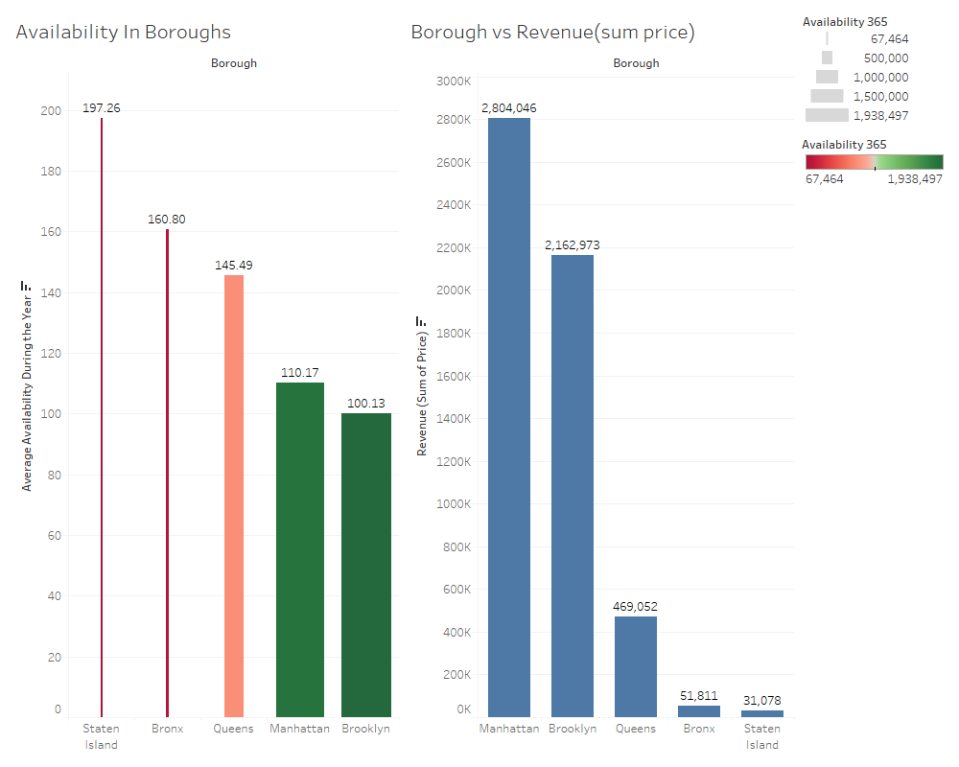
IDEAL BOROUGHS FOR EXPANSION (BY REVENUE GENERATION) - BROOKLYN AND MANHATTAN
Brooklyn sees the most rental occupancy with Manhattan following.
Manhattan generates the most revenue (with a capacity of $2.8 million per night) closely followed by Brooklyn ($2.1 million/night).
Most of commercial areas of New York City are concentrated to these two boroughs, thus making it ideal.

Slide 6
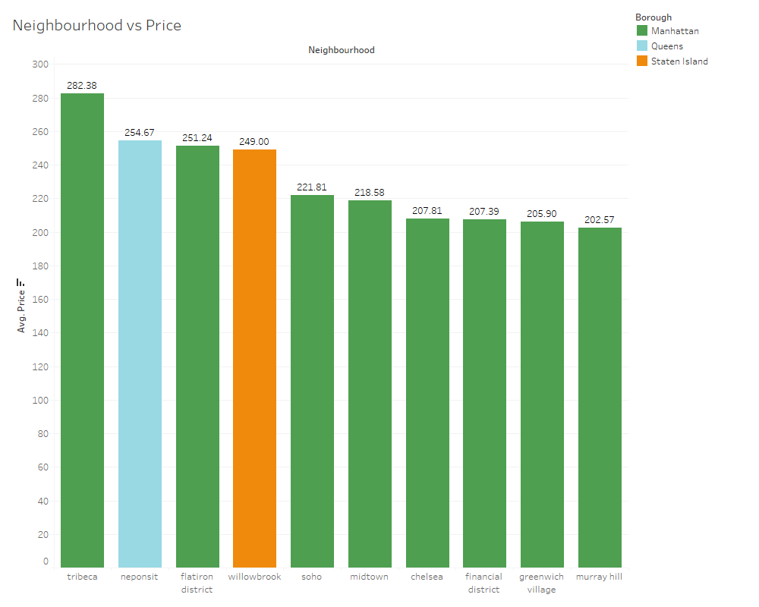
10 OF THE MOST EXPENSIVE NEIGHBOURHOODS HAVE AN AVERAGE PRICE PER NIGHT OF $200 AND UP
The average prices of residential units vary anywhere from $50 in Staten Island to $280 in Tribeca.
One of the main reasons of price inflation is the very small amount of properties that are shared. Most of the listing in New York City are entire homes, apartments and private rooms.

Slide 7
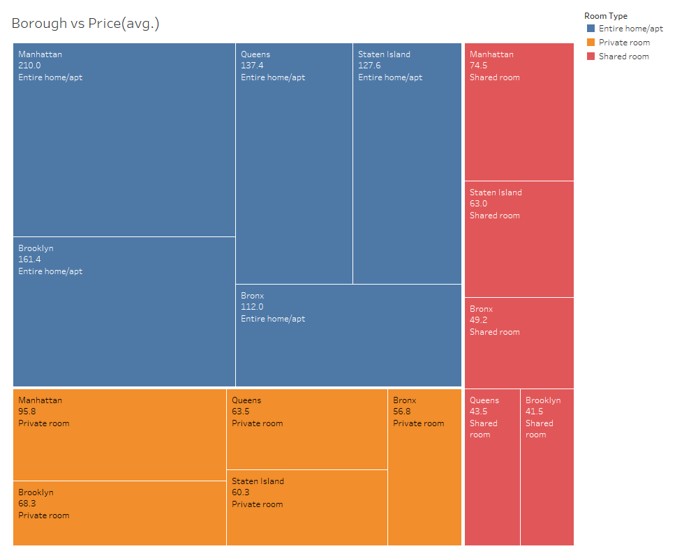
AVERAGE PRICES OF THE BOROUGHS ALONG WITH THE COMMON ROOM TYPES
Variation of prices among the boroughs ranges from $75 to $165 on an average, with Manhattan being the most expensive.
The most common room type seems to be entire home/apartment listings
A traveller with paid-for accommodation would prefer entire home listings if they are travelling with family, or private rooms if alone.

Slide 8
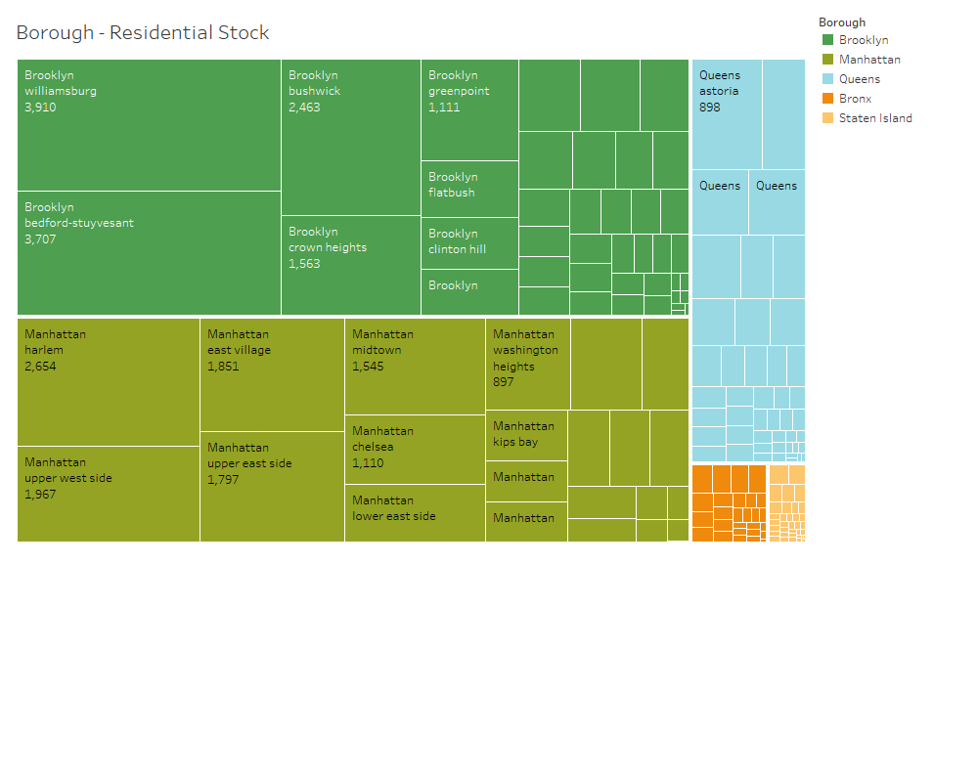
BROOKLYN HAS THE BIGGEST RESIDENTIAL HOUSING STOCK
Brooklyn with a total count of 19k properties, followed by Manhattan (17k) are the boroughs with the biggest residential housing stocks
9 of the top 10 neighbourhoods by stock are in either of these boroughs.

Slide 9
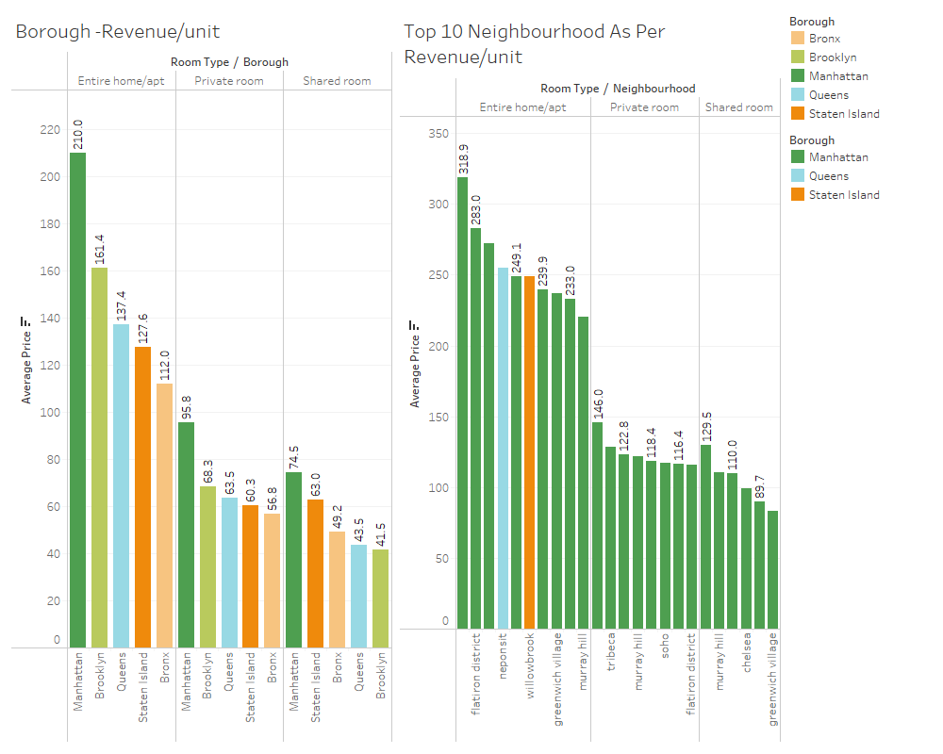
MANHATTAN AND ITS NEIGHBORHOODS ARE THE MOST PROFITABLE
Manhattan and its neighborhoods generate the highest revenue as well as the highest revenue per unit.
Two neighbourhoods outside Manhattan, namely Neponsit (Queens) and Willowbrook (Staten Island) also have exceptional revenue generation.

Slide 10
RECOMMENDATIONS
If expensive Boroughs (such as Manhattan and Brooklyn) are targeted, the customer base can be provided with affordable Room Types, such as Private Room if the customer is traveling with family, or Shared Room if the customer is traveling alone.
If less expensive Boroughs ( such as Queens and Bronx) are targeted, then the same customer base can be provided with accommodation options in Expensive Room Types, such as Entire Home/ Apt, if customer is traveling with family, or Private Room can be offered if the customer is traveling alone

Slide 11
APPENDIX - DATA SOURCES
Here is a snapshot of our data dictionary:
Data on all the listing of AirBnB in New York City such as boroughs, neighbourhoods, and price distribution.
Accurate location data through latitude and longitude.
Data sources :
AirBnB dataset (provided)

Slide 12
APPENDIX - DATA METHODOLOGY
Dataset cleaning with python using different approaches for missing values and outliers.
Using tableau views and dashboards to create charts as supporting arguments to answer the business questions asked.
Using multiple parameters for visualization to narrow down to specific answers.

Slide 13
APPENDIX - DATA ASSUMPTIONS
All units in the dataset are residential units only
Price is equivalent to revenue
We have made assumptions to answer business questions (considering the perspective of a business client ) with appropriate formatting and data storytelling

Slide 14
THANK YOU

